Slide 1
Introduction Agenda

Slide 2
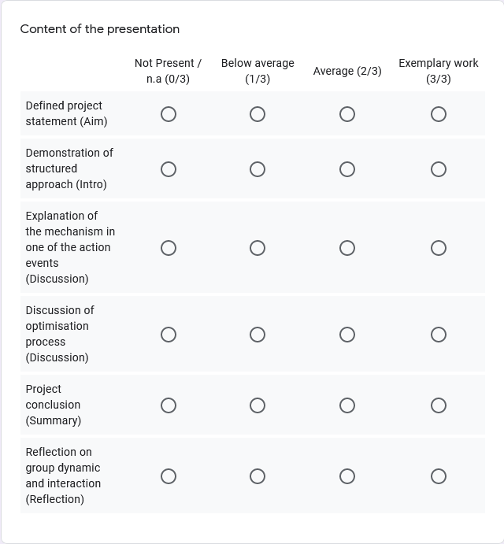
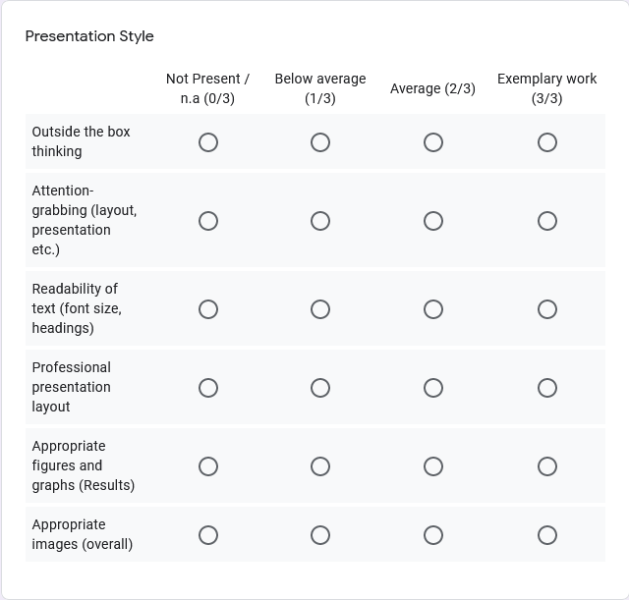

Slide 3
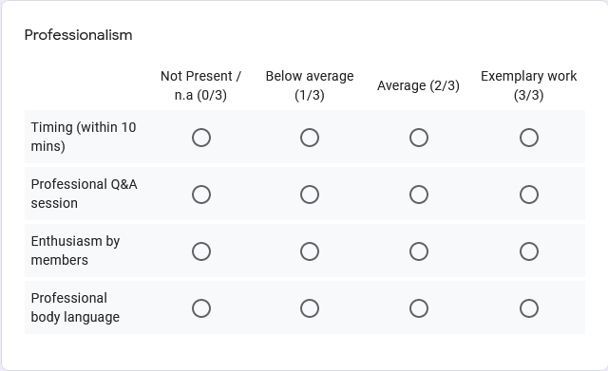

Slide 4
Preliminary Design
The Blue Jackets (T4_Nima_2)
Jai Carey (Chairman) - Shaper
Indigo Chapman (Minute-taker) – Completer Finisher
Arnav Singh – Resource Investigator
Himanshi Garg – Implementer
Faisal Anowar – Monitor Evaluator

Slide 5
Agenda
Defining “Preliminary Design”
Establish objectives
Testing models (events that could fail OFTEN)
Findings from Preliminary Designs
New implementations into our design
Challenges and what we learned

Slide 6
Defining “Preliminary Design”
Breaking down the conceptual design
Identifying issues
Make changes

Slide 7
Establish order of objectives
Turn off the alarm at the end of sequence
Conceptualise and design working RGM with 10 unique events
Minimum 3 seconds long per event
90% success rate
Total time to complete the RGM is 10 minutes

Slide 8
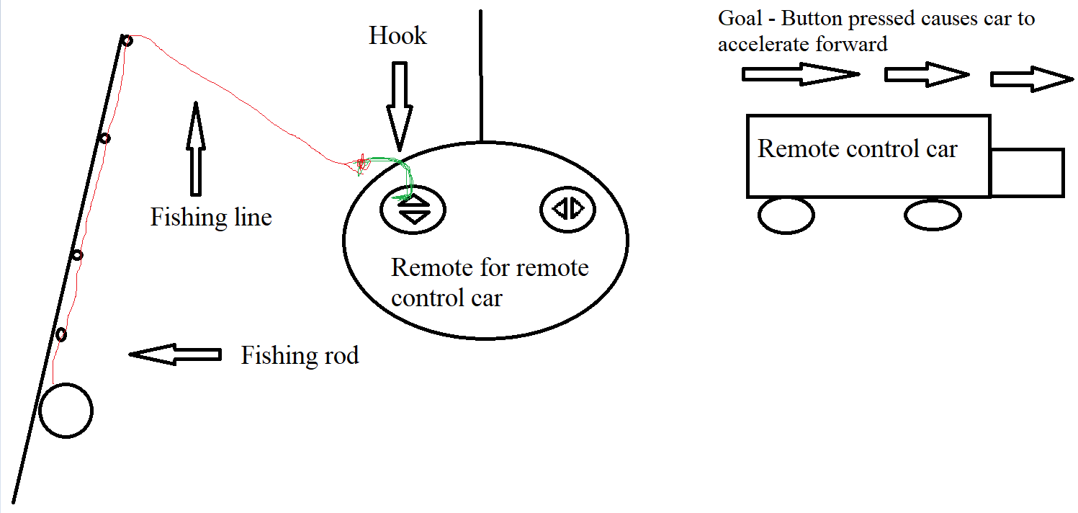
Testing Models (events that could fail OFTEN)

Slide 9
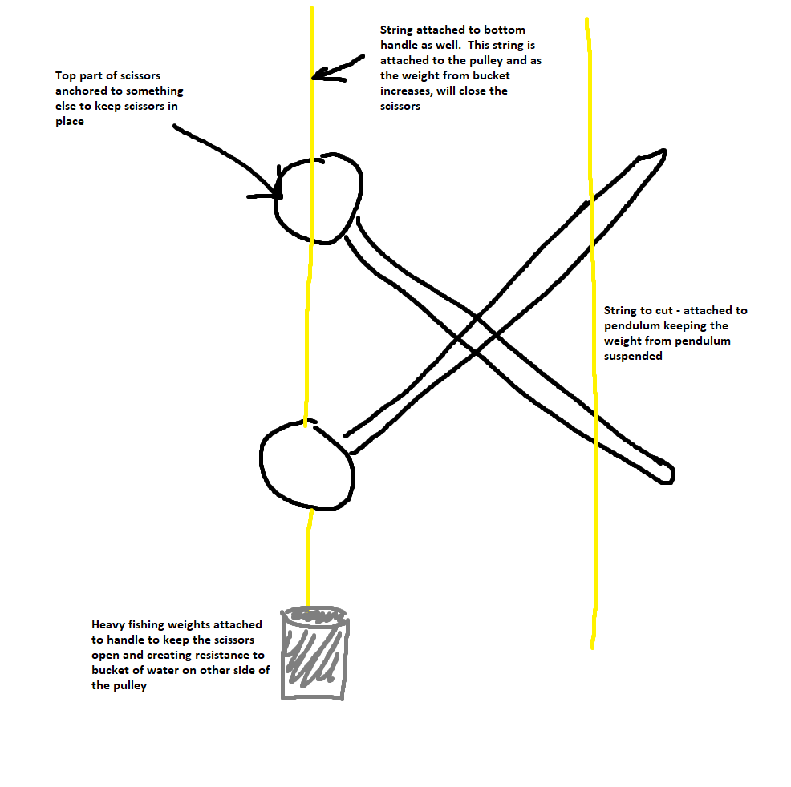
Testing Models (events that could fail OFTEN)

Slide 10
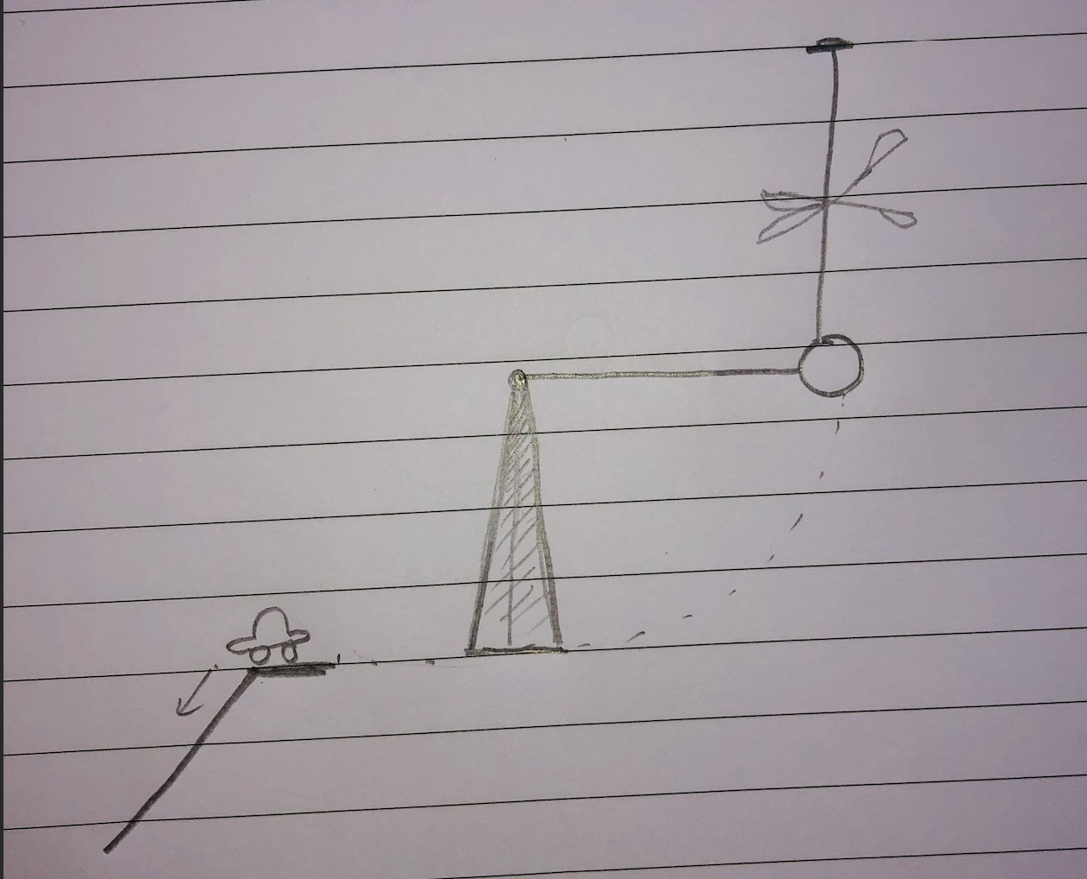
Testing Models (events that could fail OFTEN)

Slide 11
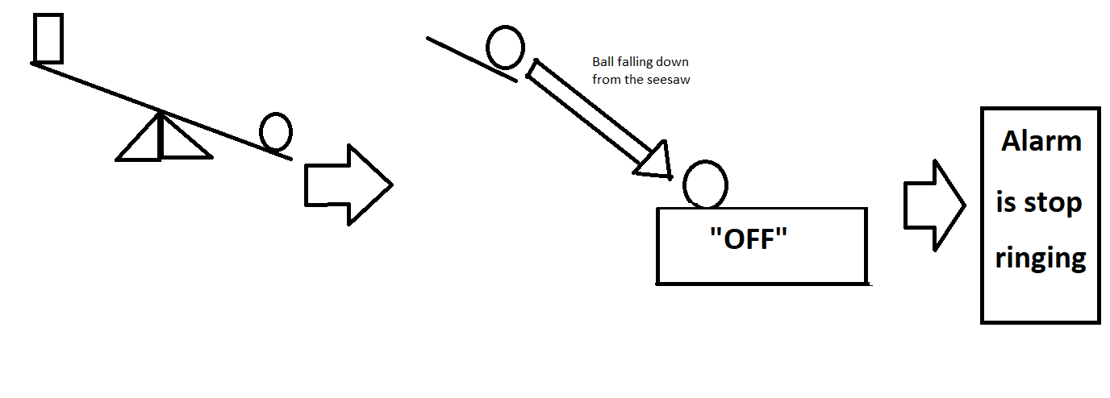
Testing Models (events that could fail OFTEN)

Slide 12
Findings from Preliminary Designs
OHS risks
Many potential failures
Material considerations

Slide 13
New implementations into our design
Removal of the hook
Securing as many aspects of the scissors and string as possible
Testing different pendulum weights and materials
Testing different materials for the ball so that it can switch off ANY alarm

Slide 14
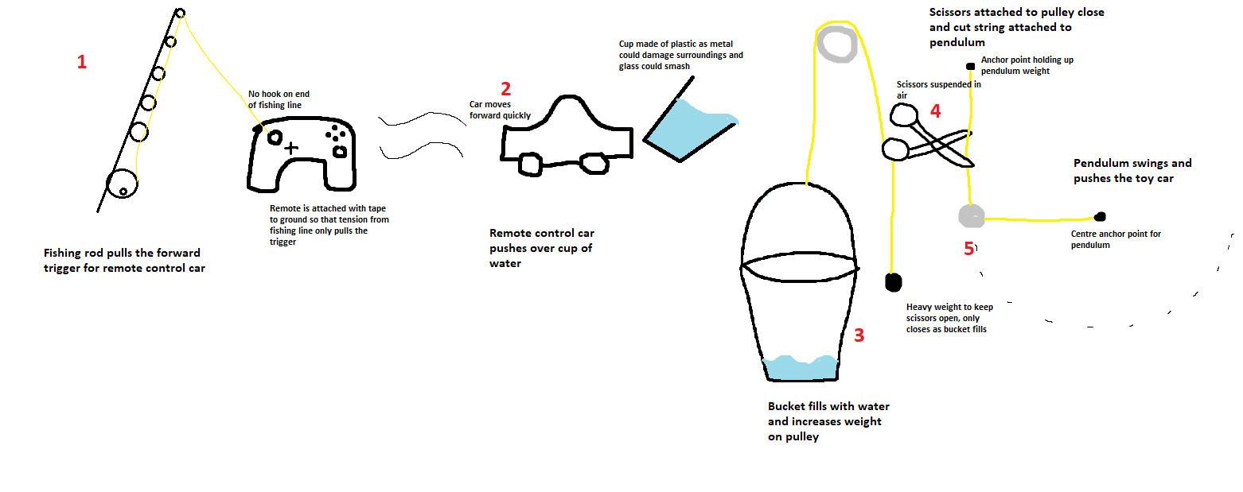
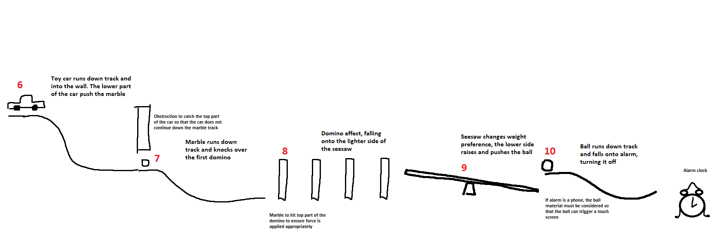

Slide 15
Challenges and what we learned
Difficulty organising meetings together
Different interpretations of questions
Differing opinions when identifying risks and creating solutions
Take time to listen to each other
Consider everyone’s opinion
Breaking down the project into more detail is beneficial!

